Slide 1

Video Game Sales and Ratings
Ana Roberta Ávila Chapa |ID: 00450987
Arturo Albarrán Rodríguez |ID: 00409156
Guillermo Beick Tapia |ID: 00415167
Alan Iván Gaona López |ID: 00444982
José Arturo Gil Bárcena |ID: 00432144
Ada Cristina Hernández Rodríguez |ID: 00406233
Sebastián Quiroz Montoya |ID: 00411408
Rodrigo Roa González |ID: 00409900

Slide 2




Project's objective from the business practical point of view
Our objective analyzing the video game sales and ratings database is to create a recommendation for the sales and marketing teams of the company, creating a tailored strategy according to our findings. We will achieve this by examining several features of the database, such as sales across different regions, customer and critic reviews, genre, and platform of the video games. By doing so we will be able to generate a new strategy for the company that emphasizes an increase in sales and customer support, as well as improving the overall quality of the products, enhancing the company’s market presence in the video games industry.

Slide 3



2. Source and description of the dataset.
Source: Video Game Sales and Ratings. (2023, 20 diciembre). Kaggle. https://www.kaggle.com/datasets/thedevastator/video-game-sales-and-ratings
Description: This dataset, showcasing video game information, offers a comprehensive overview of the industry, featuring key fields such as cumulative sales figures for North America, Japan, and Europe. Additionally, it includes insights from both professional reviewers and users, providing valuable perspectives on the quality and reception of specific products.
By examining the cumulative sales figures across different regions, analysts can discern regional preferences and market trends within the video game industry. This information enables stakeholders to tailor their strategies and marketing efforts to specific geographic markets, maximizing their reach and profitability. The average review score provided by professional reviewers, alongside the user score echoed by consumers, provides valuable insights into the overall satisfaction and perception of individual video game products. This allows developers and publishers to gauge the success and appeal of their offerings, guiding future development and marketing initiatives.

Slide 4
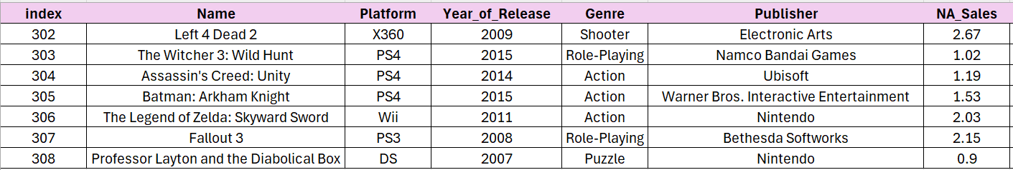
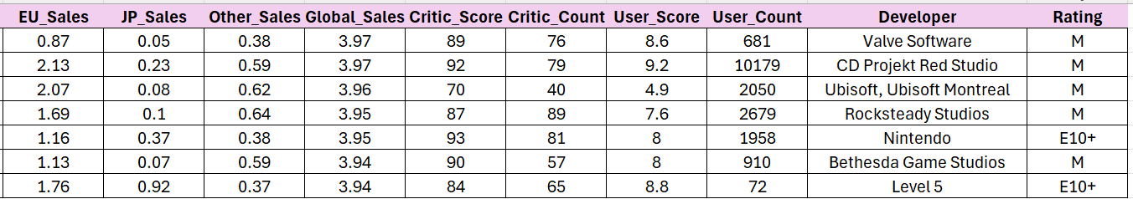
3. Data header containing at least three rows of data.

Slide 5
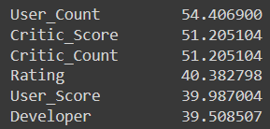
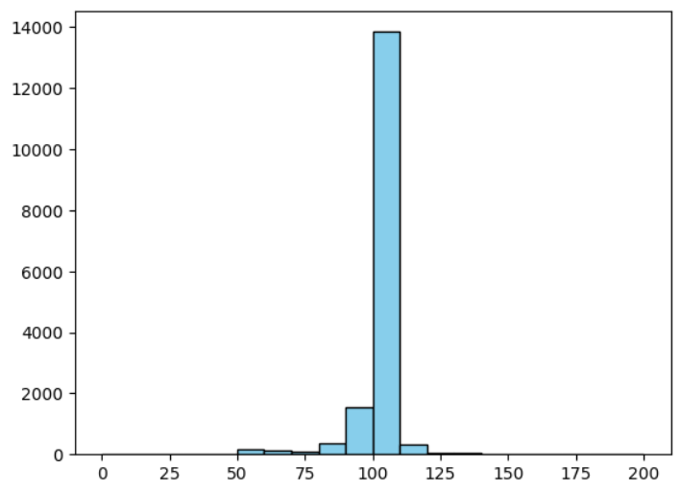
4. Potential biases and limitations in your data or project
At the time of our analysis, we noticed that several columns contained a large number of null values. To make sure, we created a table that showed the percentage of nulls in each column.
Similarly, we could see that some rows did not add up well to the total sales, as shown in the histogram, the sales do not add up to 100%.

Slide 6
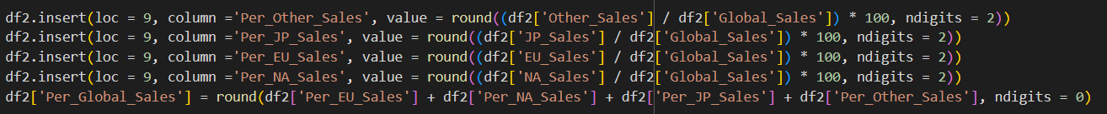
5. Feature engineering. What fields did you add and how?
We created columns that had the percentage of total sales for each region and a support column to verify that the percentages were correct. The result was as follows:
We also added a new column containing the percentile number in which the total sales of each video game was located. The code we used is as follows:

Slide 7
6. Handling of nulls and outliers.
To get rid of the nulls, the following rule was established: if a column had more than 20% of null values we would delete it. To do this we use the following code
To handle the outliers that didn’t add to 100% of the sales, we runned the next code:

Slide 8
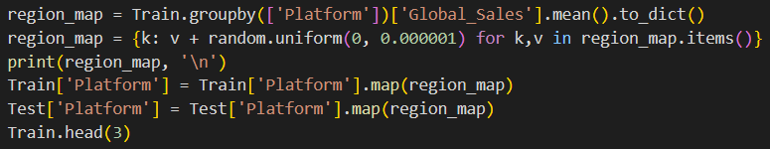
7. Categorical columns management
First we grouped all the categories that represented less than 5% of all the data and named them a new category as "other". Meanwhile, if we had too many categories, the code we used to do this is as follows:
We then performed mean coding to assign all categories the mean of their respective group to reflect their relationship to overall sales. Here is an example of how we used this technique to code the column with the video game platforms

Slide 9



8. Feature selection. Which fields were removed and why?
The fields that were removed from the original data set were "User Count", "Critic Score", "Critic Count", "Rating", "User Score" and "Developer", mainly because of their high concentration of null values. It was a pity, because they contained interesting, though scarce, information. In addition, we removed the Total percentage sales because it was only created to handle outliers.

Slide 10
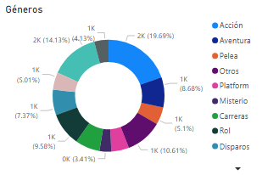
9.Exploratory Data Analysis
The circular graph illustrates the distribution of the amount of games from each genre, Adventure games hold the most significant share, with 19.69% (2448 games), followed by Sport Games at 14.13%(1757 games) and Misc at 10.61% (1319 games). The genres that have a lower market participation are: Puzzle 3.41% (424 games), Simulation with a 5.01% (623 games) and Fighting 5.1% (634 games)

Slide 11
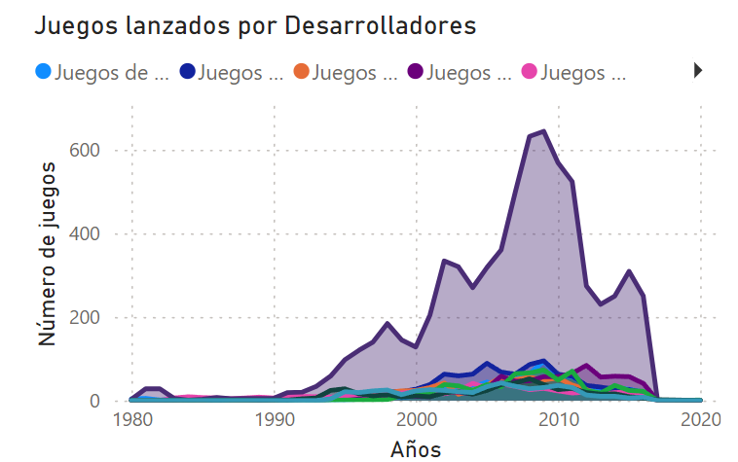
This linear graph exposes the number of games launched by different editors from 1980 to 2020, the purple line represents “Other Editors”, they consistently maintain the highest position through the years in comparison to the other editors, notably they reached their peak in 2009 with the launching of 644 games.

Slide 12
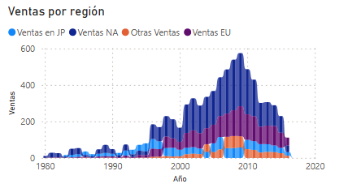
The ribbon chart shows us the changes of game Sales across four regions, Japan, North America, Europe and Other regions from 1980 to 2020. The thickness of each colored area represents the sales volume for that region in a specific year.
Overall, we can see that North America holds the largest volume of sales, they increased their sales in 1995, increasing 276% vs 1994, followed by Europe with a consistent growth in sales since 1997, then we have Japan, their sales appeared strong initially but they started to have many fluctuations, finally we have other regions, they had a gradual growth finally positioning under Japan since 2009.

Slide 13
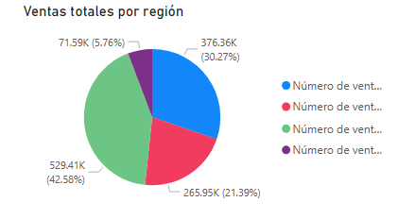
This pie chart shows us the total sales and market participation of each region in the video games market. North America has the highest sales in the market with 259.41 million (42.58%), followed by Japan with 376.36 million (30.27%), Europe ranks third with sales of 265.95 million (21.39%) and finally Other regions account for 71.59 million (5.76%) in sales.

Slide 14
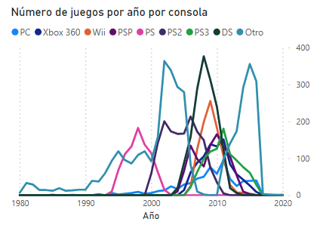
This line graph allows us to understand the trends and lifespan of each of the consoles shown over the years. As well as to understand the amount of video games there were for each console over the years. It shows that the console with the most games was the Nintendo DS with 376 games.

Slide 15
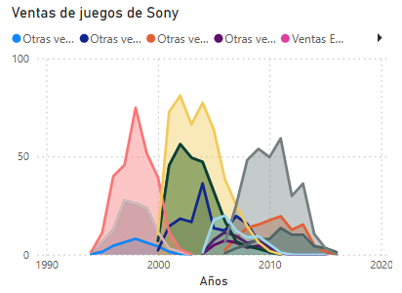
The following graph of areas shows the sales of one of the great competitors in the industry, Sony, owner and developer of the Playstation. It can be seen that in the mid 90's, it started to generate revenues and how it has been increasing its sales. Looking at the yellow line, it can be concluded that the console that sold the most games was the PS2 in the NA region.

Slide 16
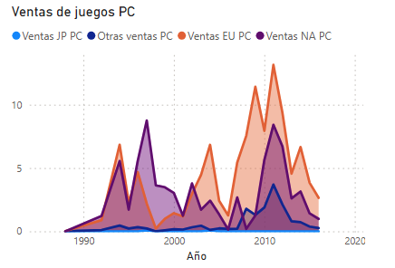
The following chart shows the net sales of PC video games over the years in different regions. It can be seen, that the region where the most PC games were sold was the US, with 2011 being the highest year.

Slide 17
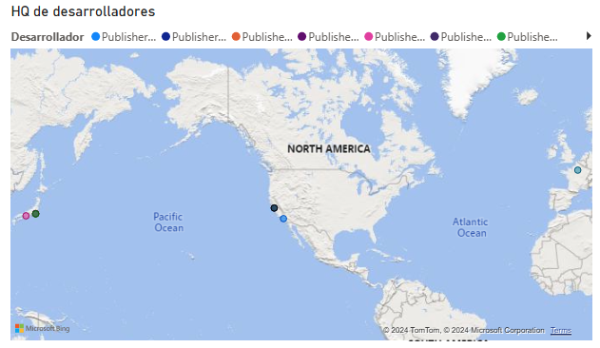
10. Map
The map on this slide allows us to see where video game developers are headquartered. As we can see, the most common locations are California, USA and throughout Japan.

Slide 18
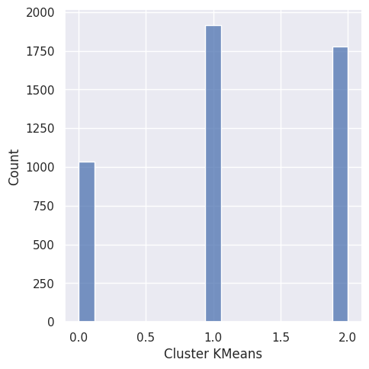
11. Machine Learning algorithms used and performance of each one.
Supervised Machine Learning
Unsupervised Machine Learning
Algorithm | Decision Tree | Random Forest Regression | XGBoost | Tunned Random Forest Regression
Accuracy | 0.7472 | 0.8513 | 0.8267 | 0.8539
RMSE | 0.5115 | 0.3922 | 0.4235 | 0.3889
Deep Learning
Algorithm | ANN
Accuracy | 0.57
RMSE | 0.723232
Cluster 0.0: Publisher is Electronic Arts, Genre is Action, Platform is PS3, and Rating is T.
Cluster 1.0: Publisher is Sonic Computer Entertainment, Genre is Action, Platform is XBOX 360 and Rating is E.
Cluster 2.0: Publisher is Electronic Arts, Genre is Shooter, Platform is Wii, and Rating is E.

Slide 19
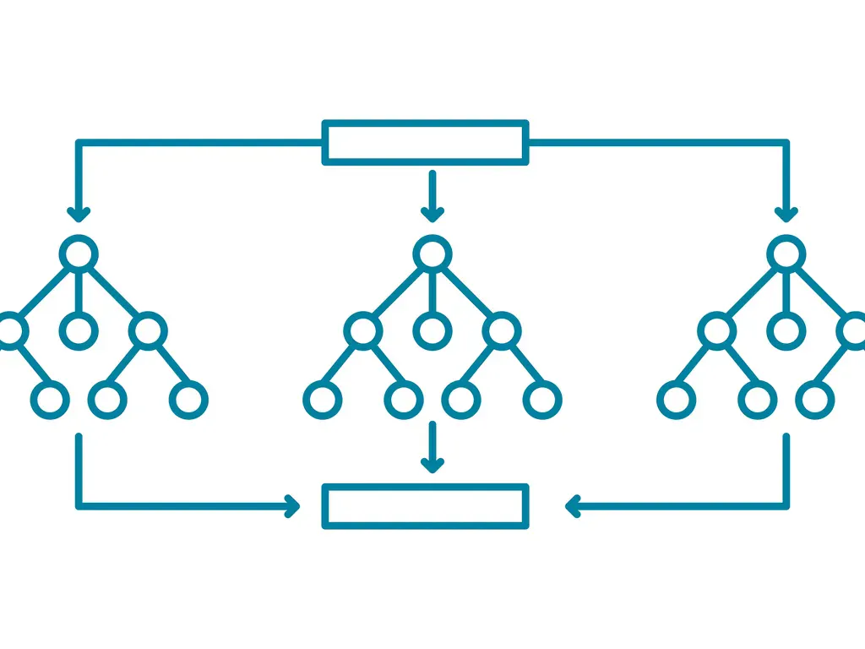
12.- Selected algorithm
For this case, we chose the Tunned Random Forest Regression because of its high accuracy of 85.39%. Although it is not the most visually attractive or comprehensible is not as complex as and computational expensive as deep learning. However, when using this model, we must consider computational resources and time constraints. Besides, it is easier to re-run in case we got new data so it has better scalability.

Slide 20
13. Fine-tune an algorithm with gridsearch in at least one project. Did you do it in this project?
Yes, in this project we employed the “gridsearch” technique to fine-tune the Random Forest model which is a valuable method for enhancing ML models. We explored various combinations within a range from 400 to 800 for the number of estimators and from 6 to 15 for the maximum depth. After conducting gridsearch, we identified the combination of parameters that resulted in the highest performance metrics. In this case, the optimal configuration consisted of 700 estimators and a maximum depth of 15. The resulted accuracy was 85.39%.

Slide 21
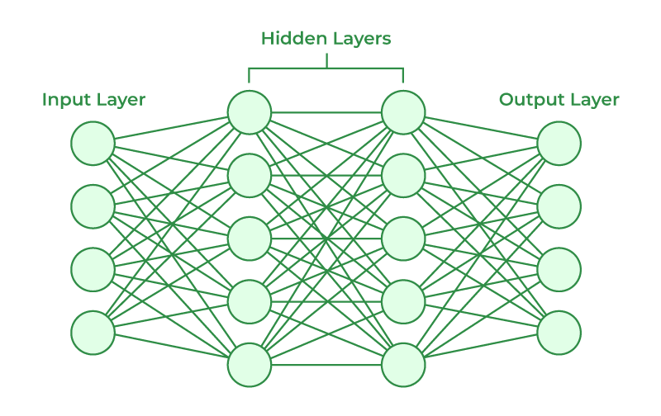
14. Apply deep learning in at least one project. Did you do it in this project?
We applied an artificial neural network to predict the North American sales number of video games. We chose a sequential model with ReLU and tanh activation functions, an adam optimizer and mean squared error as loss. The model’s accuracy was described earlier in topic 11, but overall it didn’t perform as accurate as we had expected earlier.

Slide 22

15. Create a new record and predict target using the selected algorithm
We decided to find out how many sales in North America an action game for the PS2 published by sony would get. In order to get this information, we assumed that the game sold 1 million units in Europe, 2.3 million units in Japan, earned 80 and 8.2 from reviews from critics and fans respectively, and it is rated E for everyone.
According to our Random Forest model, this game would sell 2.01 million copies in America given the information provided.
On the other hand, the deep learning model suggests it would sell 2.29 million copies in America.

Slide 23
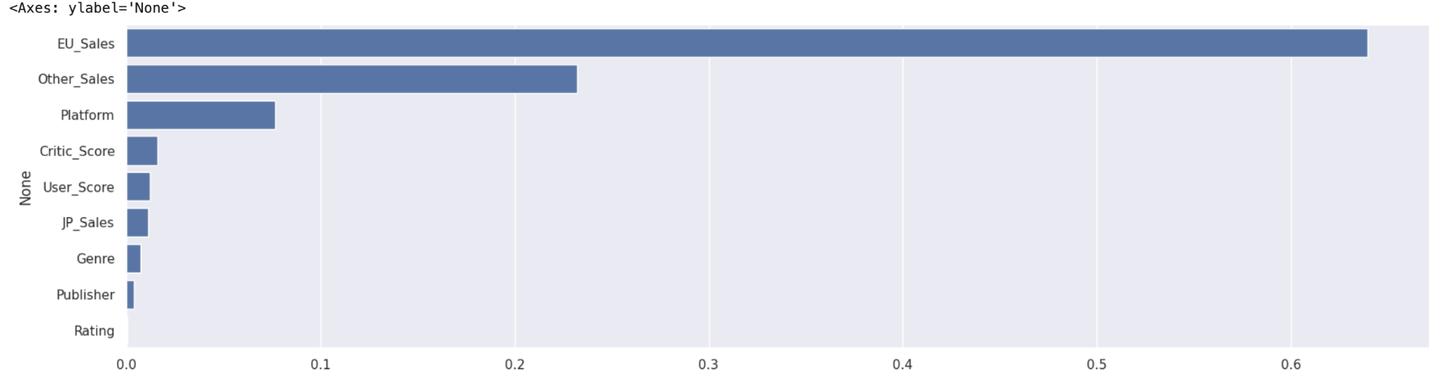
16. Feature importance of the used ones.
Decision Tree Regression
Sales on the European Union, other territories and platform are considered as the most important features by this model, and it is a trend that will continue to show up on the other ones.

Slide 24
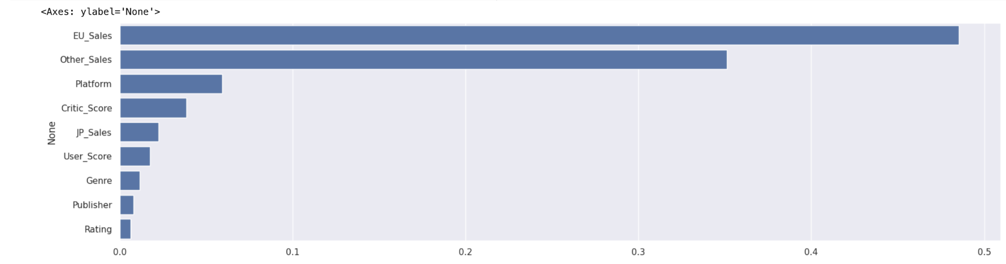
16. Feature importance of the used ones.
Random Forest Regression
The Random Forest Regression seems to consider sales in Japan as a more important metric than user score, but the remaining features remain unchanged in their importance rank.

Slide 25
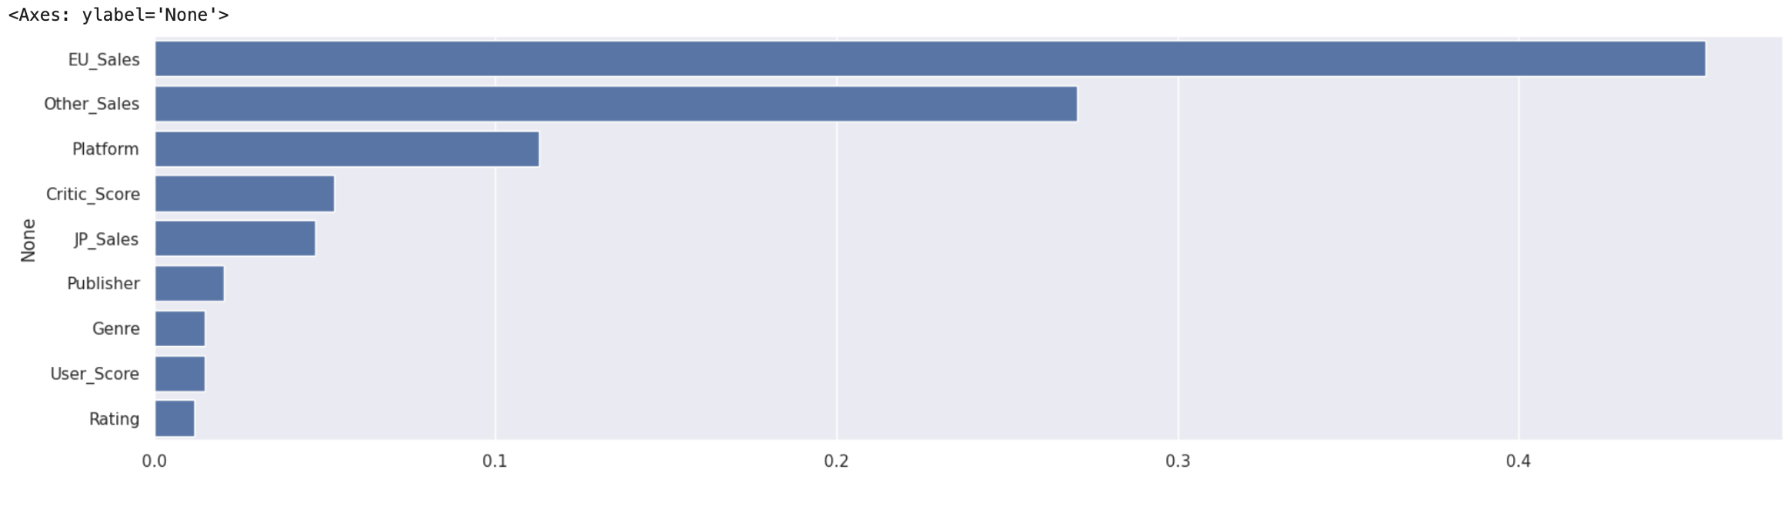
16. Feature importance of the used ones.
XGBoost Regression
The XGB model places a little bit more of importance on critic score and sales in Japan, while it still considers the former 3 features as the most important ones.

Slide 26




17. Conclusions and recommendations for the company
In conclusion, the analysis of the video game database underscores the importance of leveraging data-driven insights to optimize business strategies in the video game industry. Cumulative sales figures across key regions provide valuable market performance indicators, while opinions from professional reviewers and users offer actionable feedback on product quality and appeal.
Recommendations stemming from these conclusions include tailoring market-specific strategies based on sales trends, leveraging customer feedback for continuous product improvement, fostering deeper customer engagement, and conducting competitive analysis to maintain a competitive edge.
Implementing these recommendations can enhance the company's market presence, improve product offerings, and drive customer satisfaction. By leveraging data-driven insights and prioritizing customer-centric approaches, the company can position itself for sustained success in the dynamic video game industry.

Slide 27


18.- What did you learn in the project
One notable realization was the importance of model interpretability in addition to performance metrics. While accuracy and precision are crucial, understanding how and why a model makes certain predictions can be equally valuable, especially in industries like video games where consumer preferences can be complex and nuanced.
By aggregating the predictions of multiple decision trees, Random Forest effectively mitigates overfitting and enhances model robustness. Its ability to handle large datasets with high dimensionality makes it particularly well-suited for the complex and multifaceted nature of video game sales and reviews data.
Meanwhile, Regression analysis proved to be an indispensable tool for uncovering linear relationships between variables within our dataset. By fitting a regression model to our data, we were able to quantify the impact of various factors on video game sales and review scores.
By leveraging the unique capabilities of each method, we were able to gain deeper insights into the factors influencing video game sales and reviews, ultimately empowering more informed decision-making within this dynamic and competitive market.

Slide 28





19.- Main Issues
During the process of cleaning the video game database, we encountered several significant challenges that required careful attention and strategic solutions.
The initial state of the database was characterized by missing values. Addressing these issues demanded considerable time and effort to rectify, as we meticulously combed through the dataset to identify and correct inaccuracies. This process included tasks such as standardizing data formats, resolving conflicting entries, and ensuring data integrity across all fields.
Furthermore, ensuring the reliability and credibility of sourced data was paramount to mitigate the risk of incorporating biased or erroneous information into our analysis. This involved thorough vetting of data sources and verification of data accuracy through cross-referencing with reputable sources wherever possible. Additionally, balancing model complexity with computational constraints was essential, requiring strategic optimization efforts to maximize efficiency without compromising predictive accuracy. This involved optimizing algorithms and, at times, resorting to simpler models to work within our computational limitations.

Slide 29




20.- If you had to start the project again, what would you do differently?
If we were to begin the video game project again, we'd make some changes to make it smoother. First, we'd spend more time looking at the data before jumping into making predictions. We'd use simple pictures and charts to understand the data better, like graphs and Power BI. This would help us see any trends or weird things in the data before we start working on the predictions. It would also help us decide which parts of the data are important and which we can ignore.
Instead of starting with the hard stuff, we'd begin with the basics. For example, we'd start by making simple guesses based on what we already know or by organizing the data into groups. This would help us understand how the data works before we try anything more complicated. Starting simple would also help us figure out how different parts of the data relate to each other. Overall, our code worked fine, but taking these steps would make the project easier and help us understand the data better. By doing this, we could make better predictions and get more useful information from the video game data.

Slide 30



21.- Applications to other processes or industries
Video game databases, rich with sales and reviews data, harbor potential applications across diverse industries. In market research, this data serves as a treasure trove of insights into consumer behavior, preferences, and market trends. Retailers can harness this information to refine product offerings, optimize pricing strategies, and tailor marketing efforts to target audiences more effectively. Similarly, entertainment companies, including movie studios and streaming platforms, can leverage video game databases to discern audience preferences and tailor content offerings to align with consumer tastes.
Educational institutions stand to benefit from the gamification trend by utilizing video game data to inform the development of engaging and effective learning experiences. By understanding the mechanics and appeal of popular games, educators can create interactive educational tools that cater to students' interests and learning styles.
Moreover, the healthcare industry can explore the potential therapeutic benefits of gaming by analyzing video game data. Researchers may investigate the impact of gaming on mental health, cognitive function, and rehabilitation outcomes, paving the way for innovative interventions and treatments.

